Slide 1

Sign Language Recognition System
SRM Institute of Science and Technology
College of Engineering & Technology | School of Computing
Department of Computing Technologies
18CSC305J Artificial Intelligence – Mini Project
Team Members
RA2111027010006 Safal Mehrotra
RA2111027010007 Gaurang Ashava
RA2111027010008 Syed Adnan Hussainy
RA2111027010009 Rahul Nair

Slide 2
SOCIETAL BENEFIT
Accessibility: Enables Deaf/Hearing individuals to interact with technology and services.
Communication: Breaks down language barriers, facilitating smoother interactions.
Empowerment: Grants autonomy in expression, information access, and navigation.
Education: Integrates into educational tools, promoting cultural awareness.
Employment: Reduces barriers, enhancing job opportunities and economic empowerment.
Healthcare: Ensures clear communication for better health outcomes and satisfaction.
Legal/Civic Engagement: Improves accessibility to legal and civic services.
Research & Development: Drives innovation for accuracy and usability advancements.

Slide 3
PROBLEM STATEMENT
Statement: Sign language recognition aims to bridge communication gaps for the deaf and hard-of-hearing community by accurately interpreting sign language gestures in real-time.
Description: Sign language recognition involves developing systems that can understand and interpret sign language gestures performed by individuals.
These systems typically utilize computer vision and machine learning techniques to analyze and recognize hand movements, shapes, and positions.
The goal is to create accessible communication tools that enable seamless interaction between sign language users and non-signers, promoting inclusivity and accessibility in various domains such as education, employment, and social interactions.

Slide 4
OBJECTIVE WITH TECHNICAL DEPTH
Objective: Develop a highly accurate Sign Language Recognition System (SLRS) to empower Deaf and Hard of Hearing individuals, addressing key technical challenges:
- Utilize advanced computer vision techniques for precise gesture detection and tracking.
- Extract relevant features from sign language gestures using state-of-the-art algorithms.
- Incorporate linguistic models for context-aware interpretation of sign language.
- Implement temporal modeling to capture sequential dependencies in gestures.
- Employ data augmentation for robustness in diverse environments.
- Design intuitive user interfaces and integrate with assistive technologies.
- Ensure scalability and compliance with accessibility standards.
- Establish mechanisms for continuous improvement and adaptation.

Slide 5
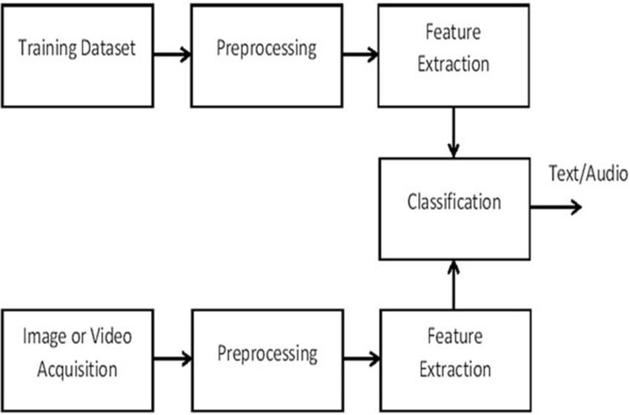
SIGN LANGUAGE SYSTEM WORKFLOW

Slide 6
PROPOSED WORKFLOW
1. Input Acquisition and Preprocessing:-
Capture Video Input: Utilize a camera or sensor-equipped device to capture video input of sign language gestures.
Preprocessing: Enhance image quality and remove noise through preprocessing techniques to optimize gesture recognition.
2. Hand Gesture Detection and Tracking
Computer Vision Analysis: Analyze video frames using computer vision techniques to detect and track hand movements and gestures.
Key Point Identification: Identify key points such as fingertips, palm contours, and hand orientation for accurate gesture recognition.
Algorithm Implementation: Employ advanced algorithms like convolutional neural networks (CNNs) for real-time gesture classification.

Slide 7
PROPOSED WORKFLOW
3. Multimodal Analysis
Facial Expression and Body Movement Analysis: Analyze facial expressions and body movements to provide additional context for sign language interpretation.
Enhanced Communication: Incorporate multimodal inputs to enrich the accuracy and richness of communication within the system.
4. Gesture Interpretation and Mapping
Linguistic Model Integration: Map recognized gestures to a linguistic model for interpretation within appropriate grammatical and semantic contexts.
Syntax and Semantics Analysis: Integrate language models trained specifically for sign language, considering syntax, semantics, and contextual cues.
5. Output Generation
Text or Speech Synthesis: Convert interpreted sign language into natural language text or synthesized speech output.
User Preference Adaptation: Provide output in the preferred format of the user, such as visual displays, text outputs, or auditory feedback.

Slide 8
PROPOSED WORKFLOW
6. Feedback Mechanisms
Error Correction and Suggestions: Incorporate feedback mechanisms to correct recognition errors and provide suggestions for alternative interpretations.
Iterative Improvement: Continuously improve the accuracy and reliability of the SLRS through iterative feedback-driven processes.
7. User Interface Delivery
Accessible Interface Design: Deliver processed output through a user-friendly interface tailored to the accessibility needs and communication preferences of the user.
Visual, Textual, or Auditory Output: Provide output in various formats, including visual displays, text outputs, or auditory feedback.

Slide 9
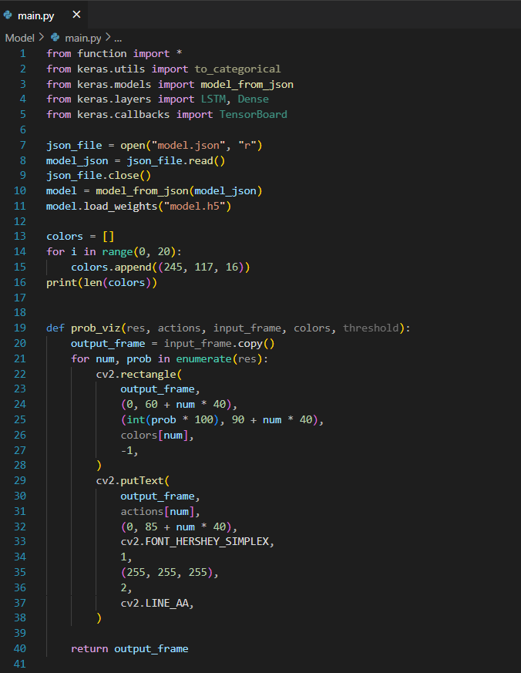
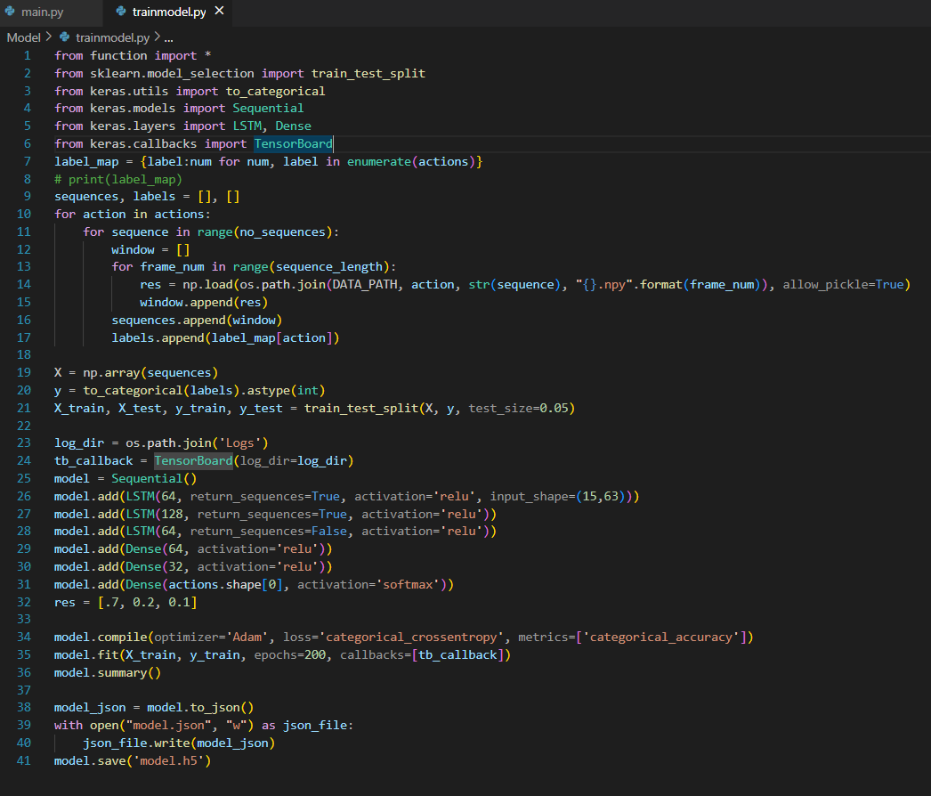
IMPLEMENTATION
CODE:-

Slide 10
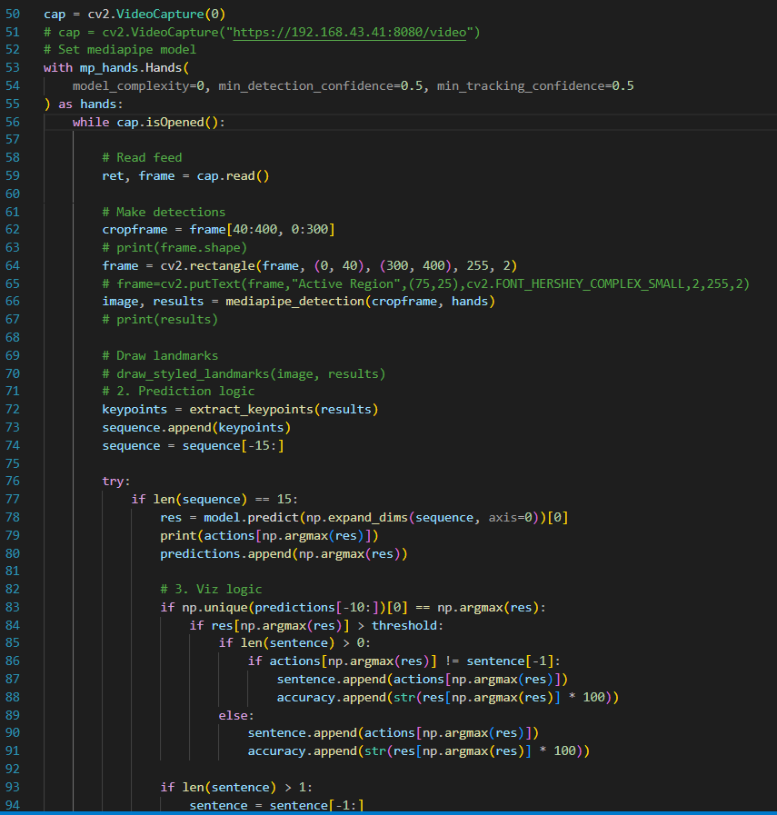
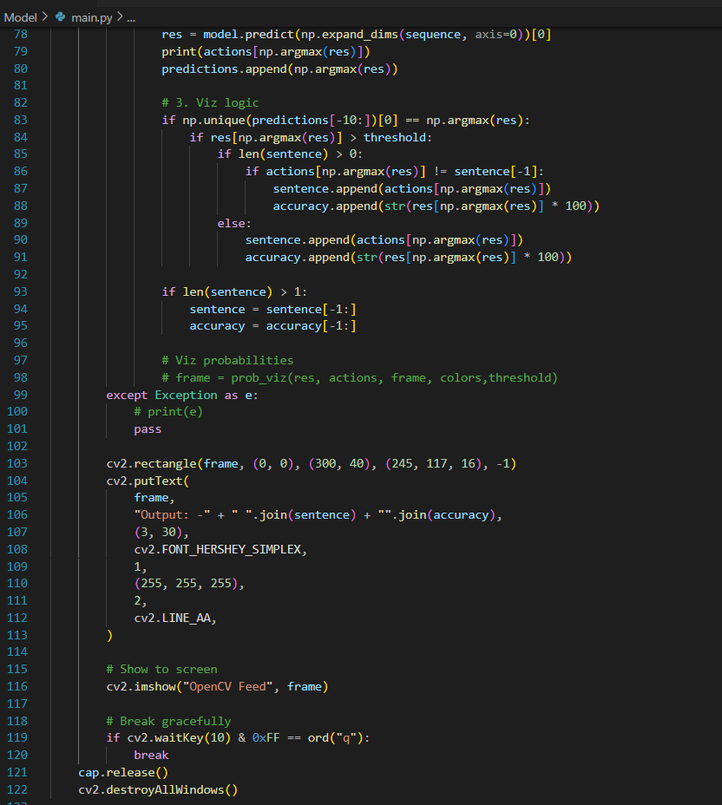
IMPLEMENTATION
CODE:-

Slide 11
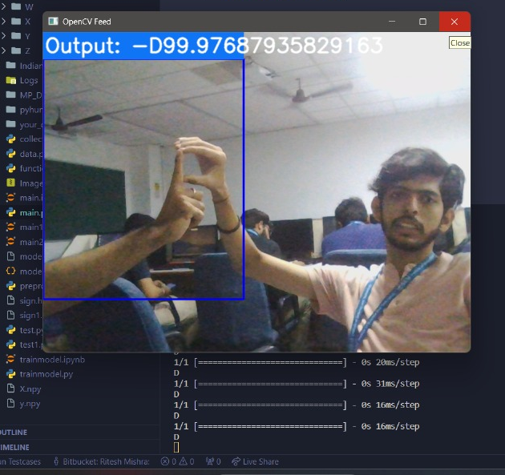
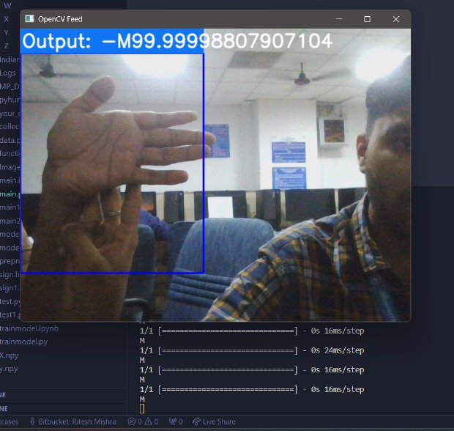
PREVIEW
OUTPUT:-

Slide 12
THANK YOU

